Slide 1
Algorithms, pseudocode and flowchart
Part II (Flowchart)

Slide 2
Contents
Definition
Symbols
Flowchart constructs
Examples and Exercises

Slide 3
Definition
In the context of computer programming, an flowchart, is defined as a:
“Diagrammatic/Graphical representation of sequence of steps to solve a problem.”
“Flowchart is a graphical tool that diagrammatically depicts the steps and structure of an algorithm or program”

Slide 4
Contents
Definition
Symbols
Flowchart constructs
Examples and Exercises

Slide 5
Symbols
Symbol Name | Symbol | Function
Oval |  | Terminal: Indicates start or end of the program or algorithm
Parallelogram |  | Input/Output: Input or output of data
Rectangle |  | Process: Any type of internal operation: data transformation, data movement, logic operation, etc.
Diamond |  | Decision: Evaluates a condition or statement and branches depending on whether the evaluation is true or false
Arrows |  | Flow lines: Arrows that indicate the direction of the progression of the program
Circle |  | Connector: Connects sections of the flowchart, so that the diagram can maintain a smooth, linear flow

Slide 6
Contents
Definition
Symbols
Flowchart constructs
Examples and Exercises

Slide 7
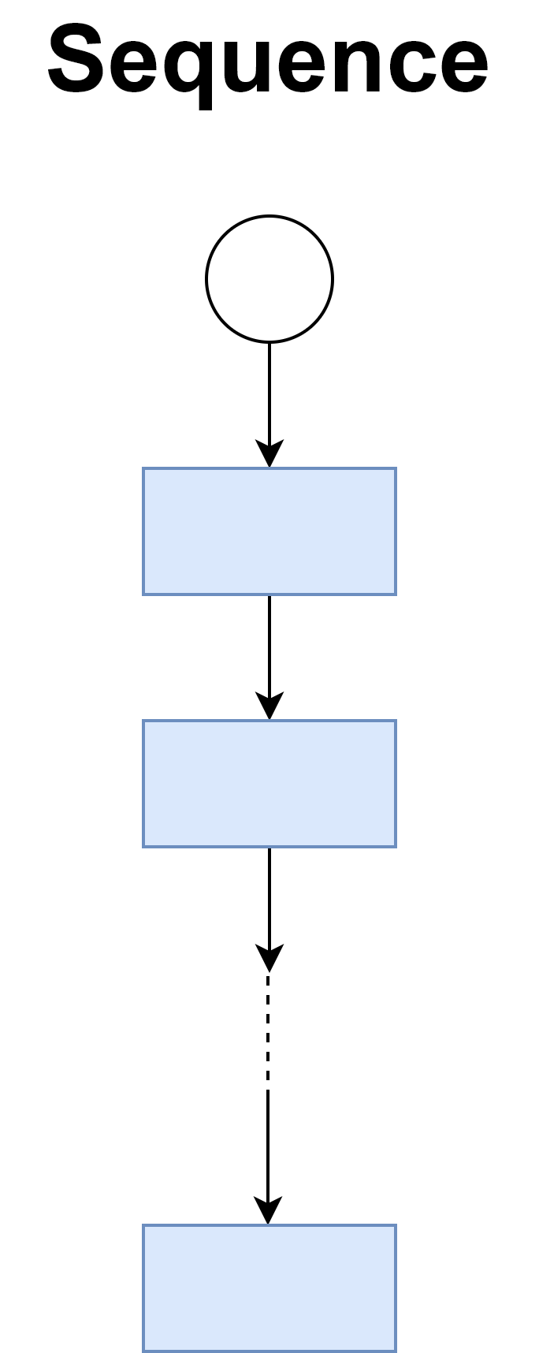
Sequence

Slide 8
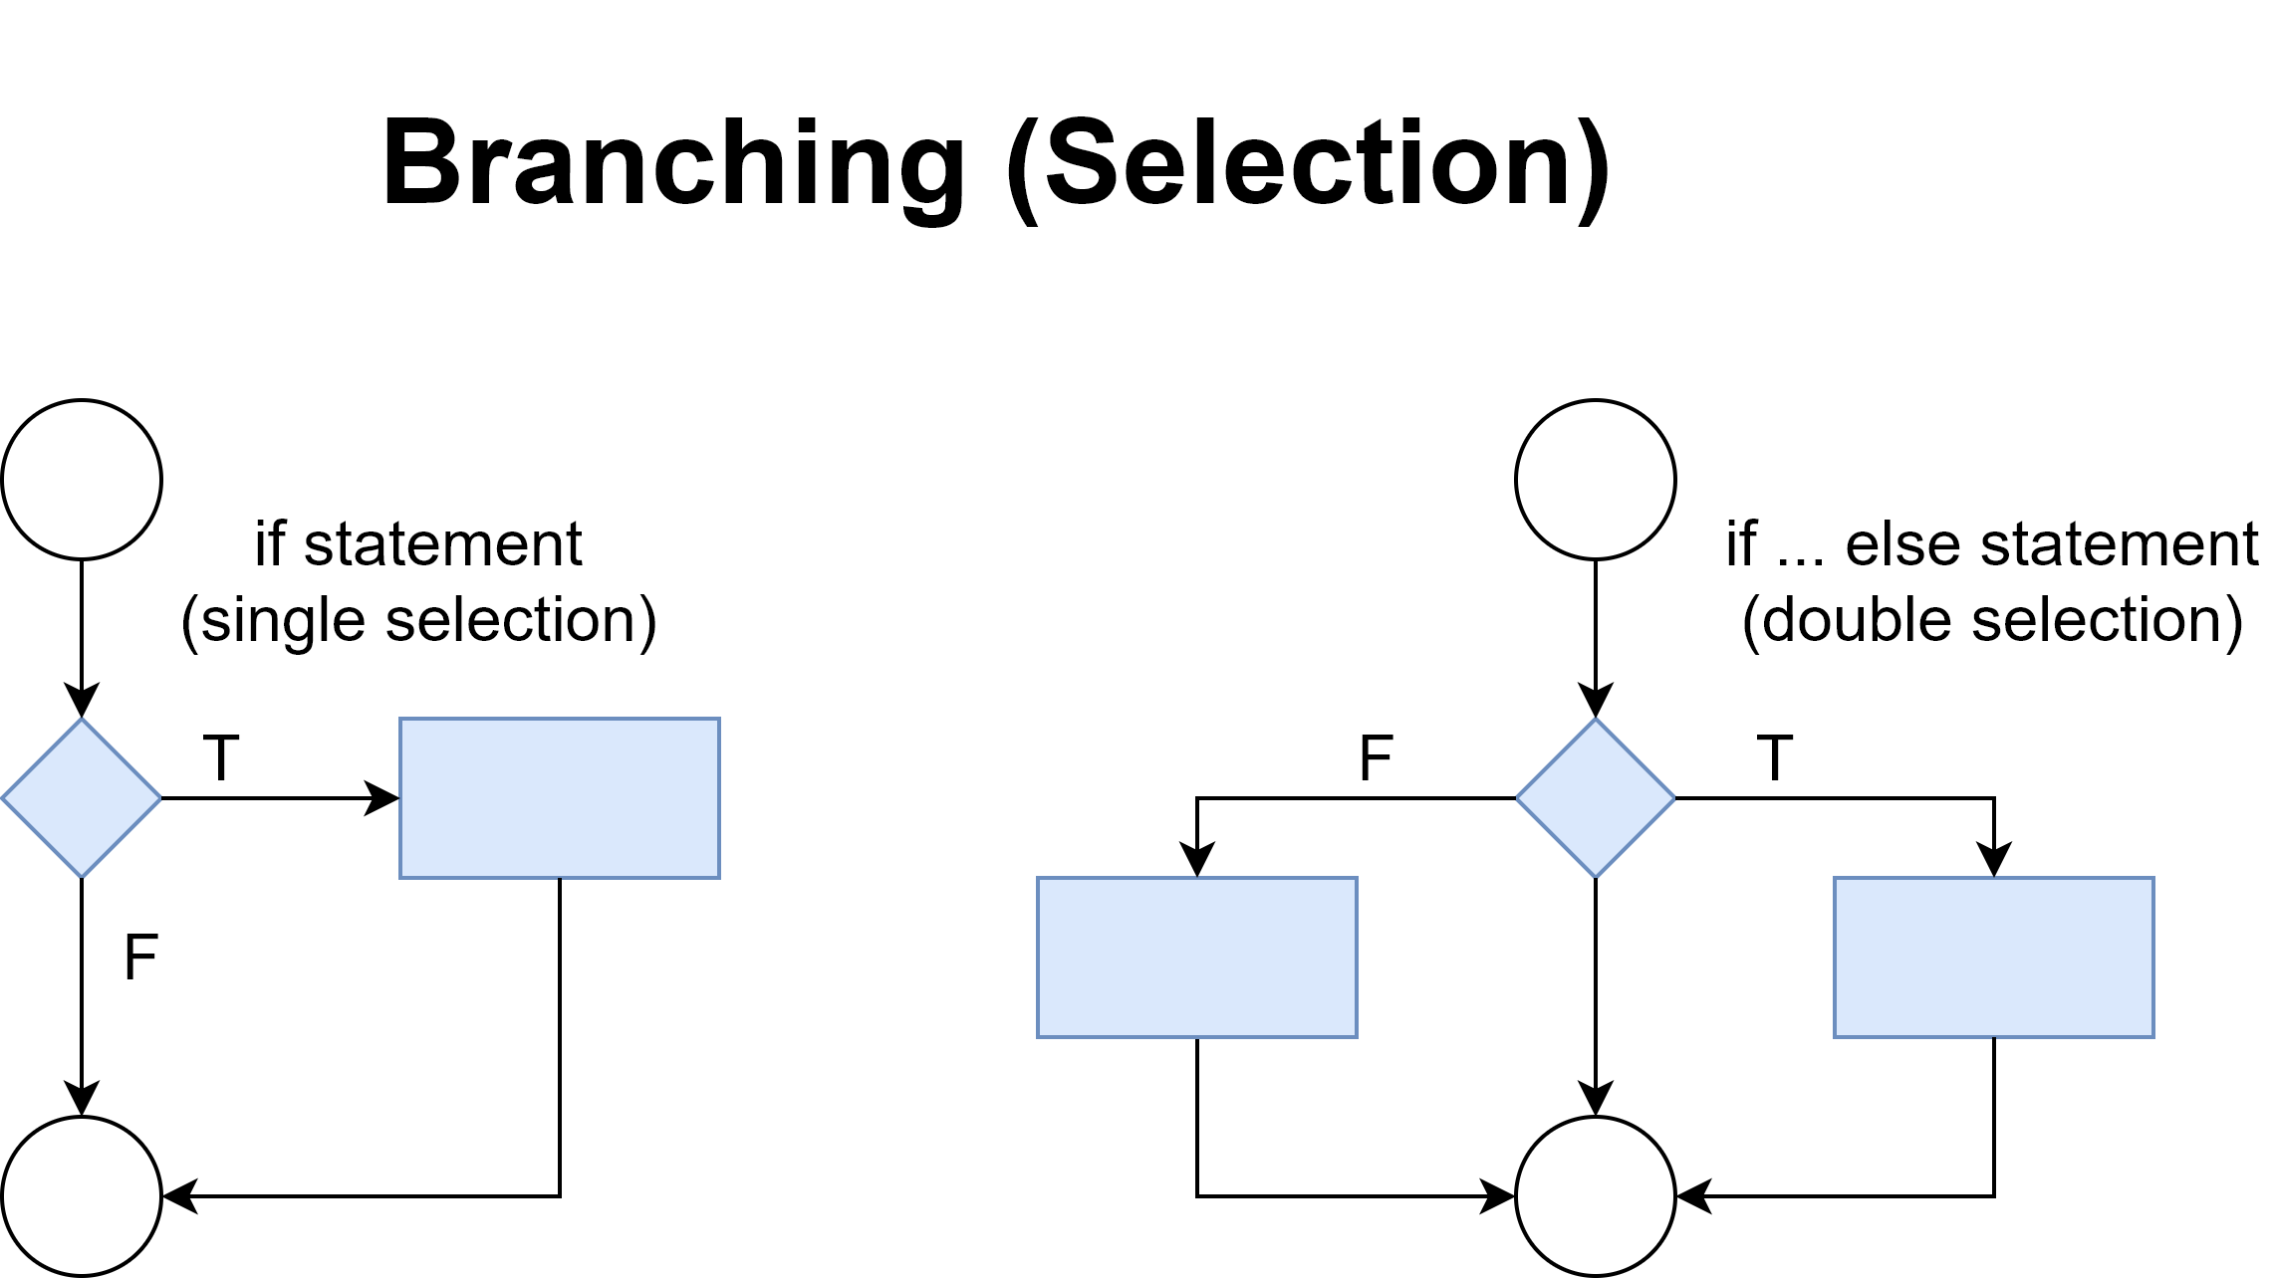
Branching (Selection)

Slide 9
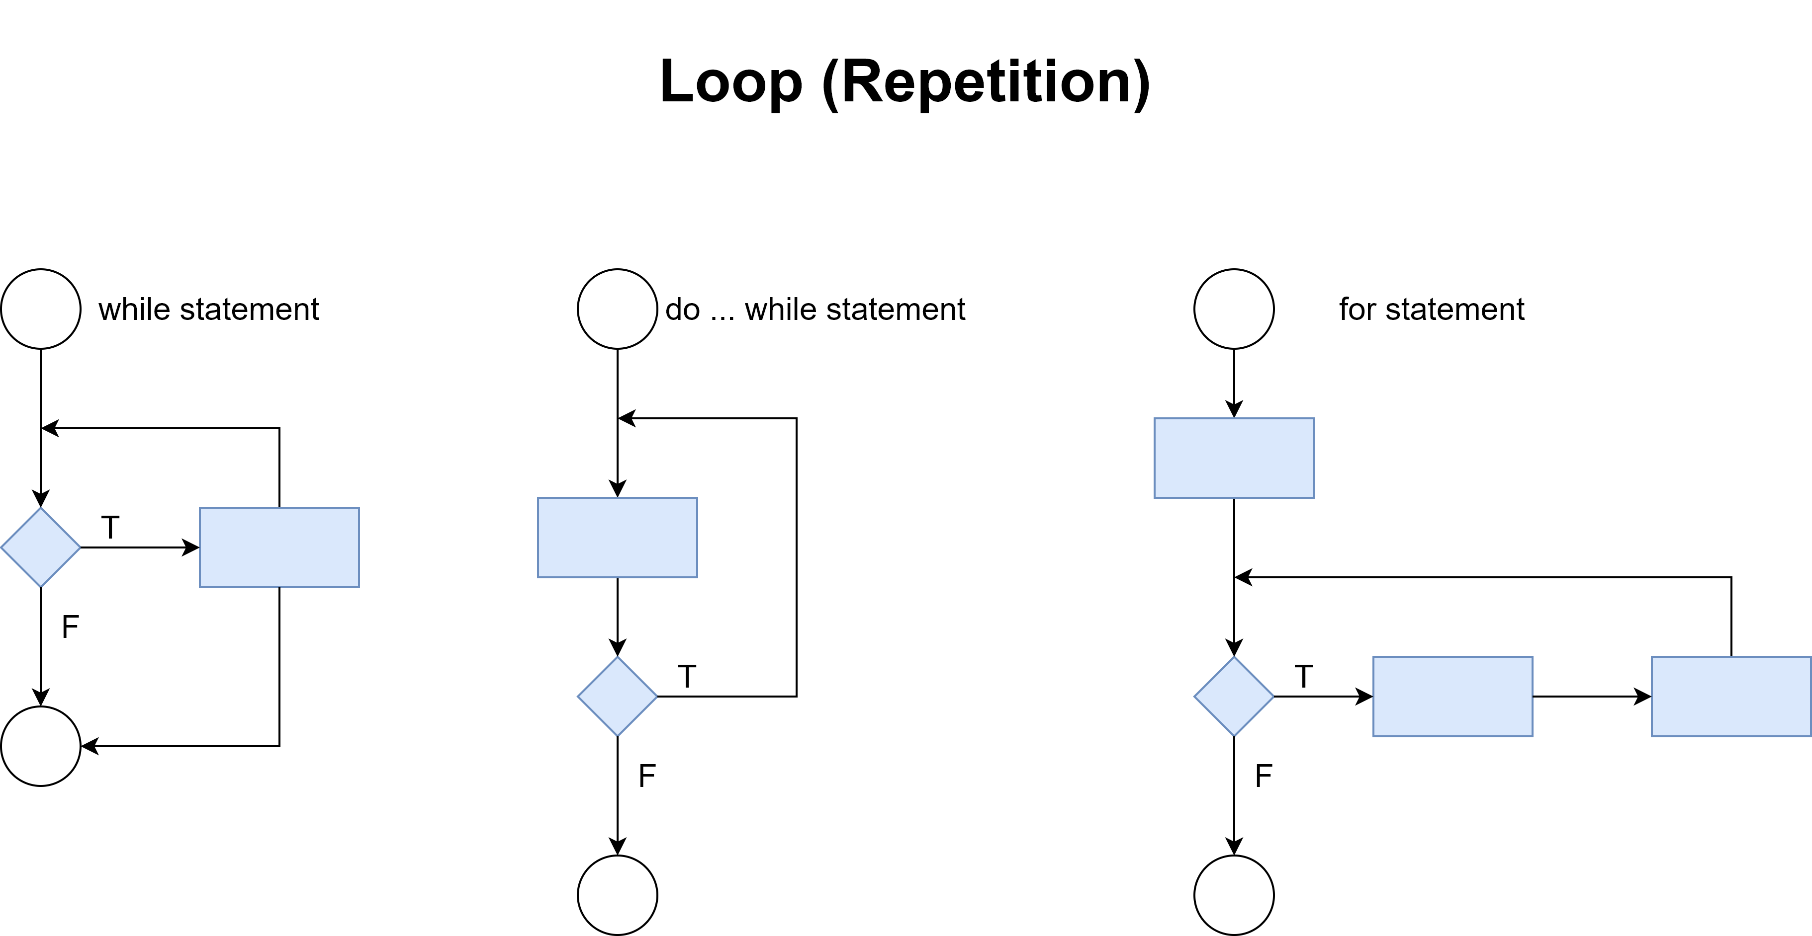
Loop (Repetition)

Slide 10
Contents
Definition
Symbols
Flowchart constructs
Examples and Exercises

Slide 11
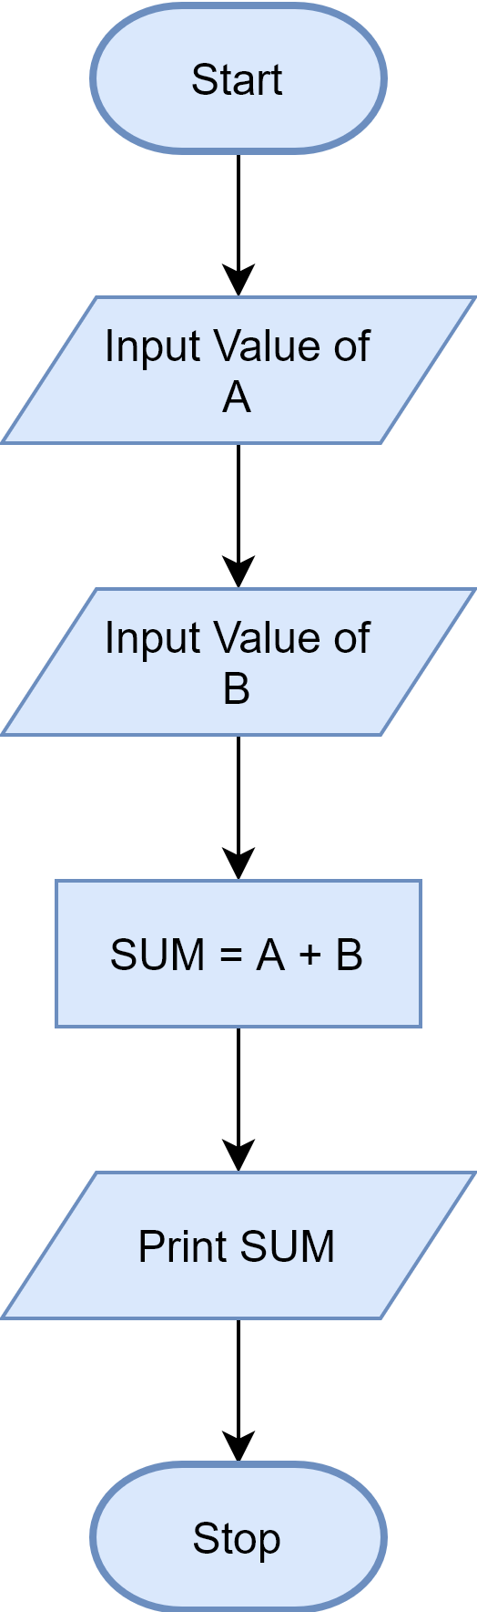
Example 1
Flowchart to find the sum of two numbers

Slide 12
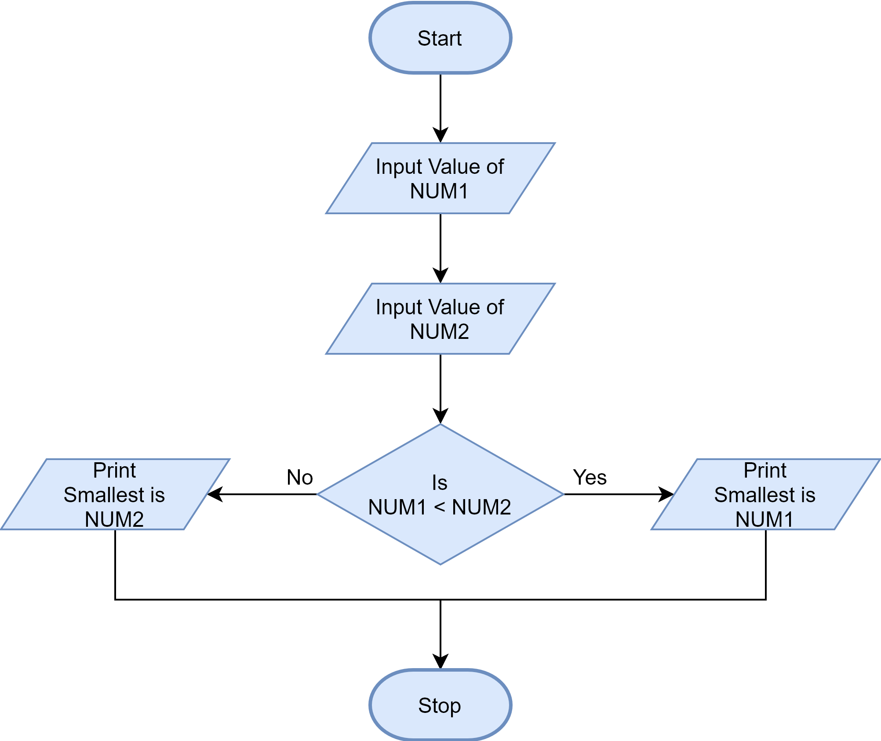
Example 2
Flowchart to find the smallest of two numbers

Slide 13
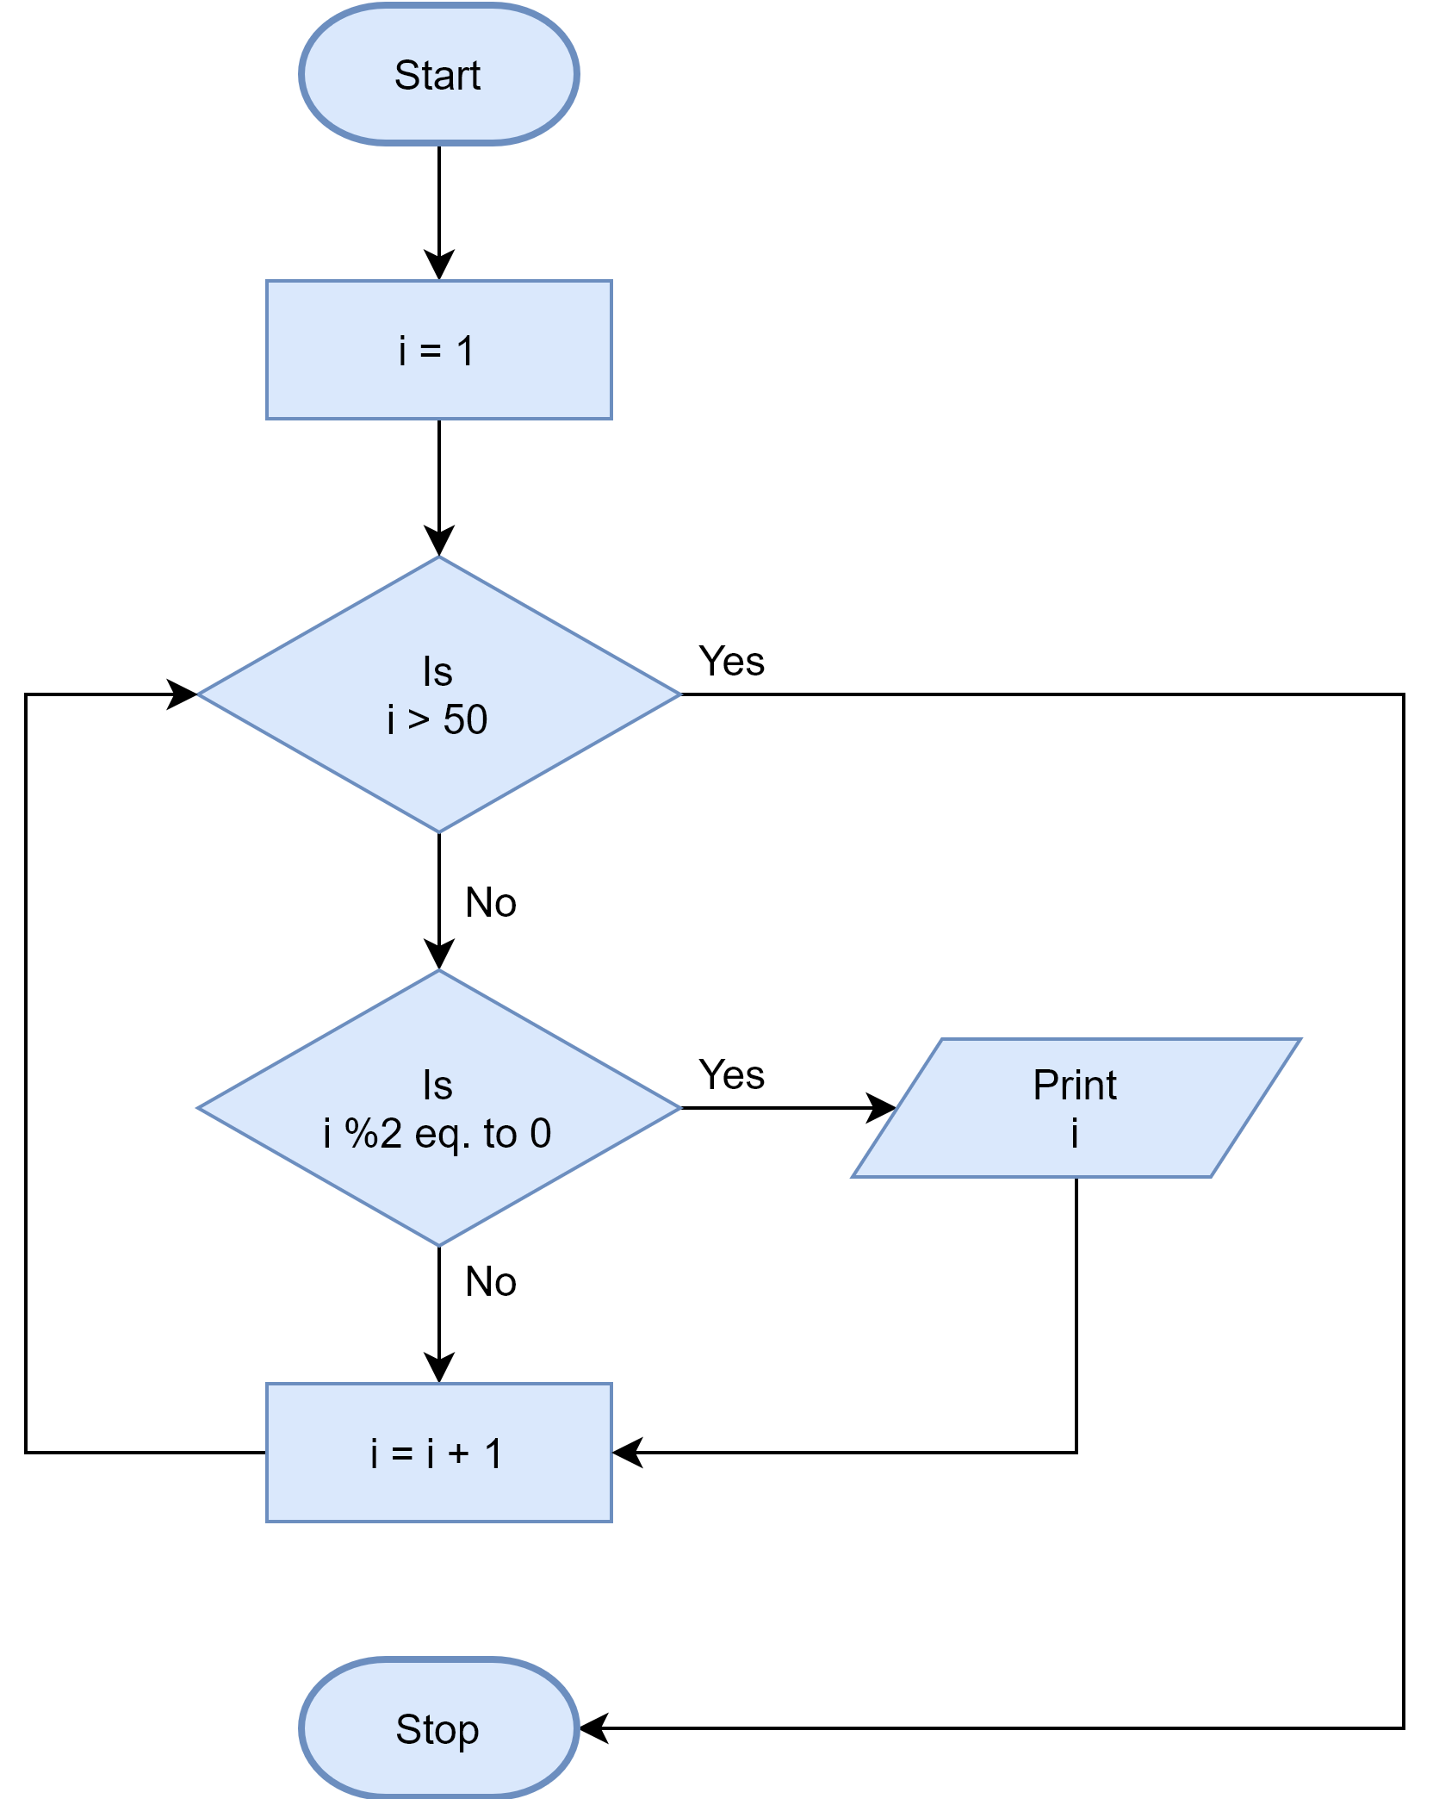
Example 3
Flowchart to find Even number between 1 to 50

Slide 14
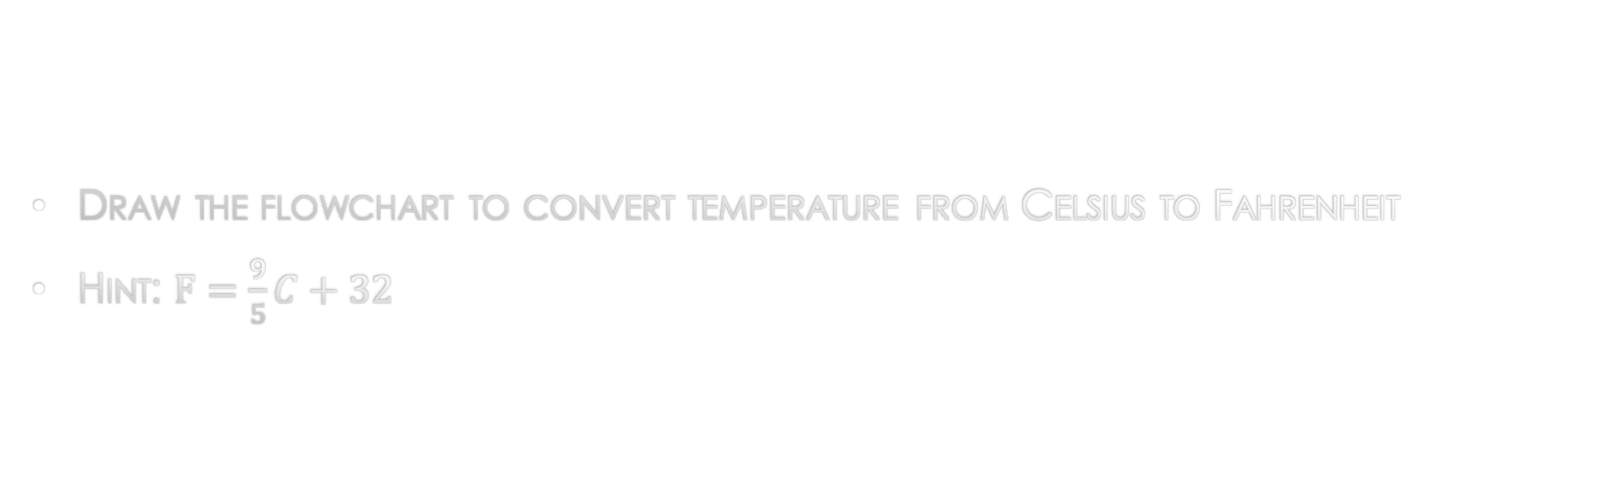
Exercise 1
Draw the flowchart to convert temperature from Celsius to Fahrenheit
Hint: $F=\frac{9}{5}C+32$

Slide 15
Exercise 2
Draw the flowchart to find the largest of two numbers

Slide 16
Exercise 3
Draw the flowchart to find the largest of three numbers

Slide 17
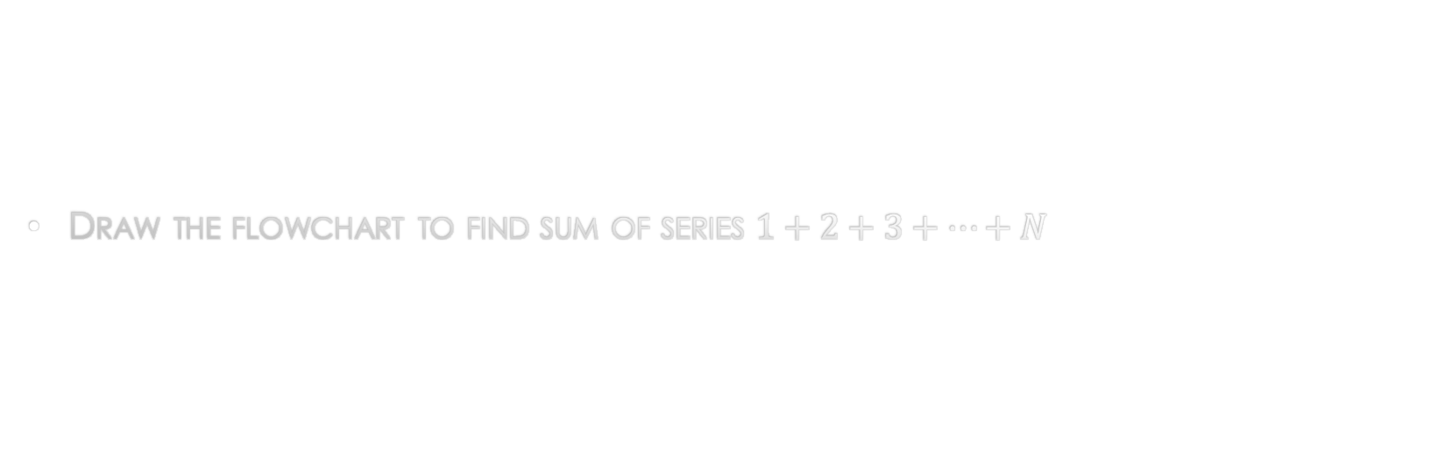
Exercise 4
Draw the flowchart to find sum of series $1+2+3+…+N$

Slide 18
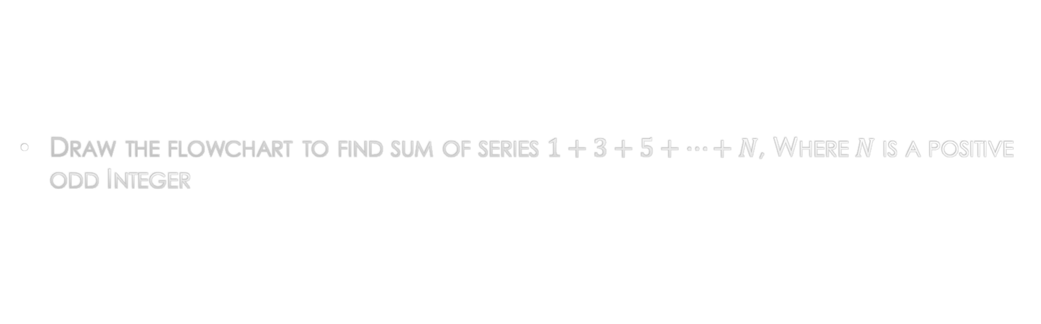
Exercise 5
Draw the flowchart to find sum of series $1+3+5+…+N$, Where $N$ is a positive odd Integer

Slide 19
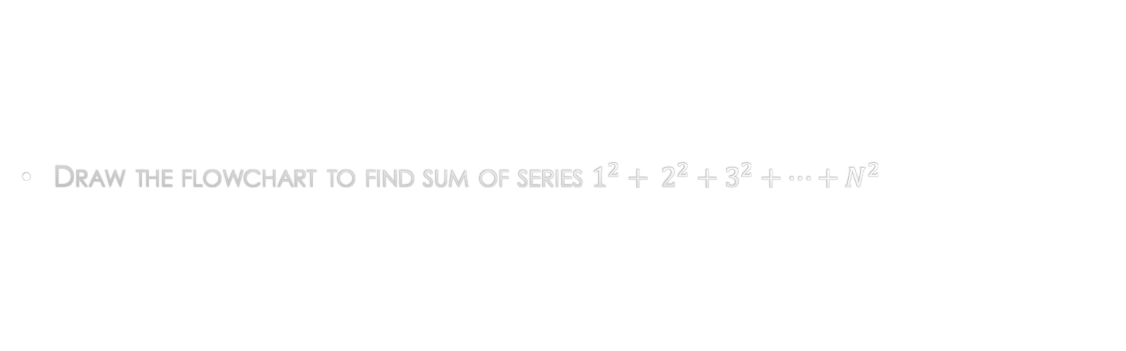
Exercise 6
Draw the flowchart to find sum of series $1^{2}+ 2^{2}+3^{2}+…+N^{2}$

Slide 20
The end

